Slide 1
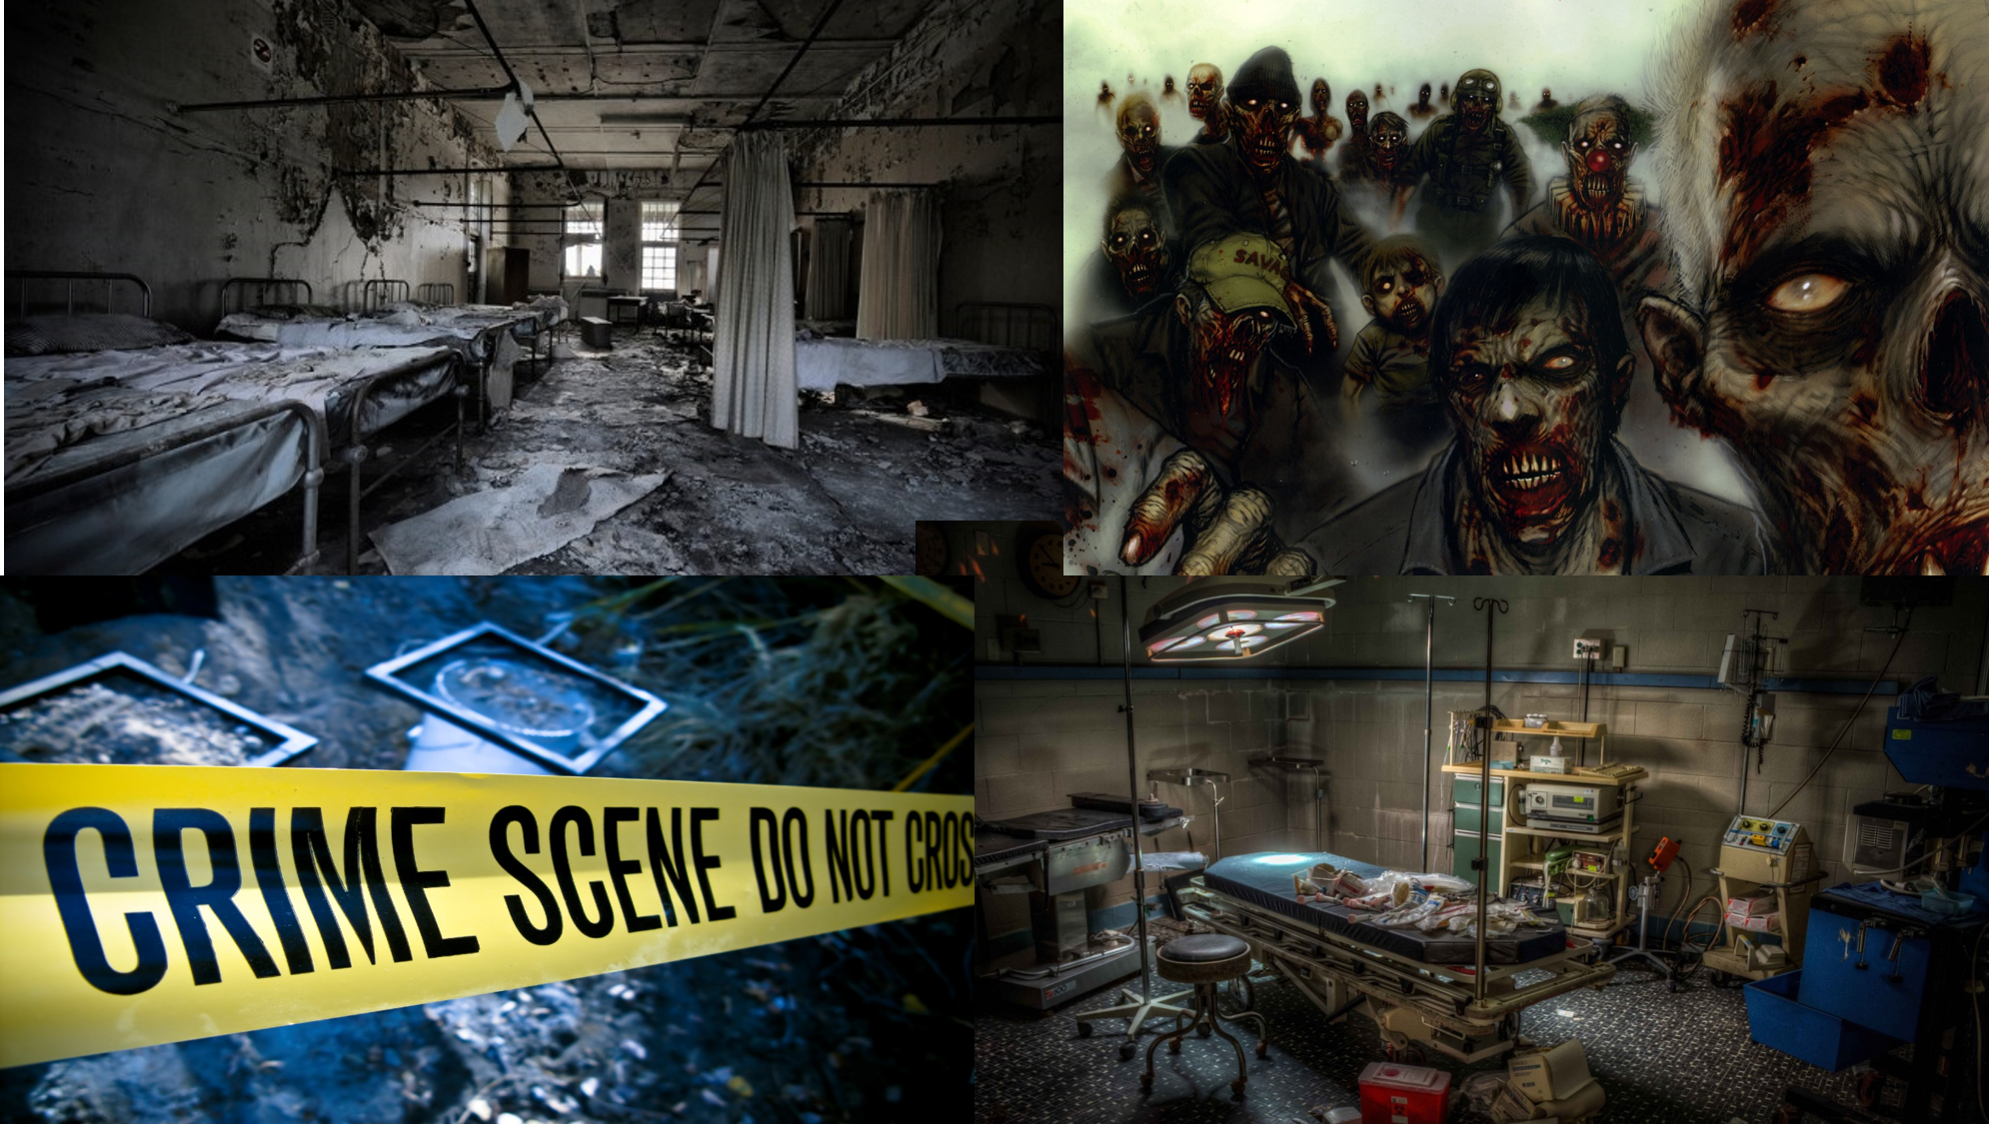
Hospital Z
Notes:
All- Our game is called Hospital Z

Slide 2

Game Trailer

Slide 3
Group 16
Akansha Garg
Gabe Whale
Ryan Harris
Ellie Robins
Bedoor Bahassan
Oliver Bradford-Tolley
Jiayi Chen
Chienn Ngu

Slide 4
Game overview
Abandoned hospital
Escape routes
Deaths/Endings
Notes:
Gabe- talk about the environment the game is based in
Akansha- escape routes, deaths

Slide 5
Main Features of The Game
Difficulties
Energy levels
Fighting abilities
Randomization
Craft building
Time countdown
Notes:
Micheal

Slide 6
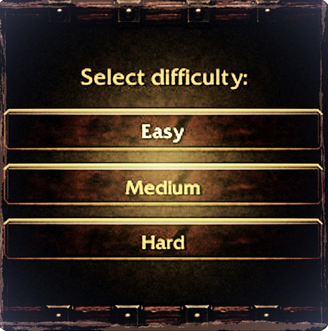
Difficulty levels
Easy – unlimited lives, energy decreases at a slower rate.
Medium – 6 lives, energy decreases at a faster rate.
Hard – 1 life, energy decreases at the fastest rate.
Notes:
Akansaha

Slide 7
Energy
Begin game at a midway on energy level.
Gain energy by eating,.
Lose energy by time countdown, walking up/down stairs, moving rooms.
X-ray room has major impact – faster countdown in this room and then energy drops more dramatically.
Notes:
Bedoor

Slide 8
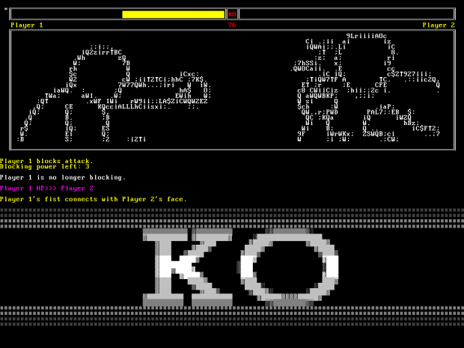
Fighting abilities
Fighting turn by turn based.
Use weapons found in game.
Harder the difficulty changes the damage the weapons you are fighting with can do.
Fighting can change end of game result – if lose fight infected by zombies and lose a life/lose game.
Notes:
Chienn

Slide 9
Craft building
Find items throughout hospital building in game
Use items to build a certain craft that can be used to escape
Notes:
Gabe

Slide 10
Time countdown
General countdown in whole of game in order to make it a rush so its more exciting to find an escape.
X-ray room countdown faster for that individual room – running out of time can result in a death
Notes:
Ellie

Slide 11
Randomisation
There are hiding places for each item.
Every item is vital for survival during the game.
Every game item is randomly hidden throughout game.
Makes game more interesting as it will change every time.
Notes:
Akansha

Slide 12
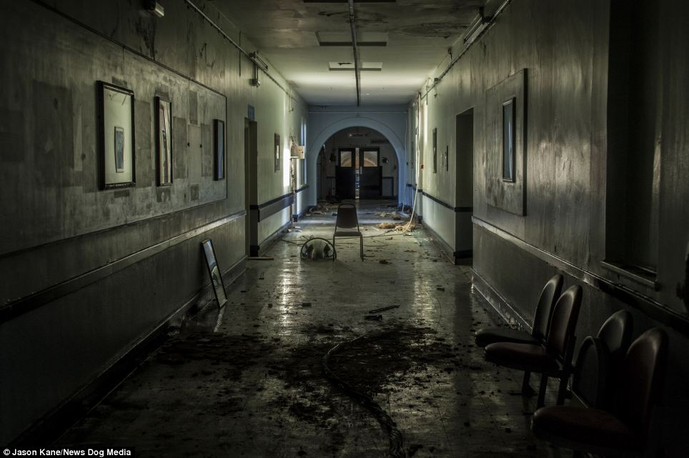

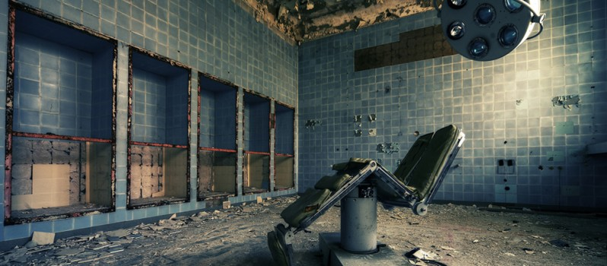
Enjoy our demonstration of
Hospital Z
Notes:
Ryan and Ollie

Slide 13
Thank You For Listening
Any Questions?
Notes:
Ryan and ollie

